Slide 1
LONG NON-CODING RNA
PHANG LAB TALK
MAY 03, 2012

Slide 2
Transcriptome
The collection of all transcripts (RNA) presents in a given cell
~5 % codes for proteins
The rest codes other variety of RNAs

Slide 3
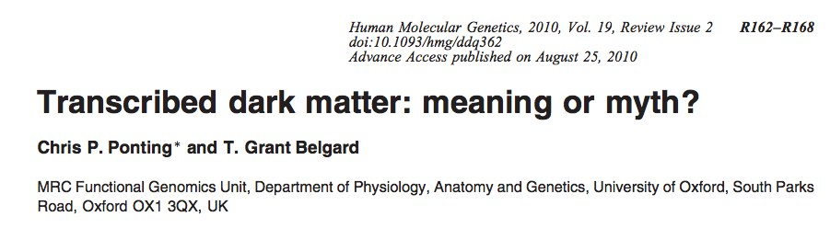

Slide 4
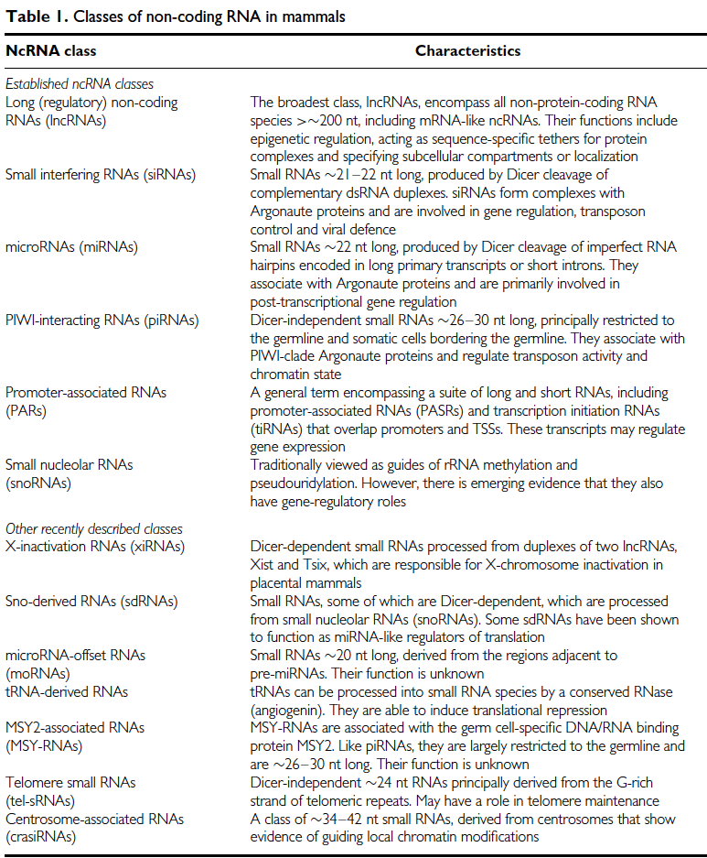

Slide 5
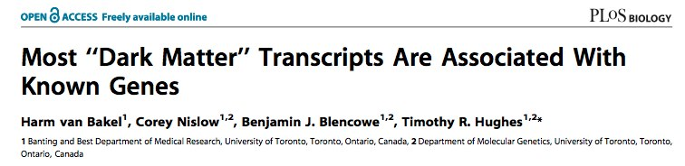
Speculation!
Most of the genome is transcribed into some form of RNAs
However, there are skeptics
Take Timothy R Huges’ Group claims

Slide 6
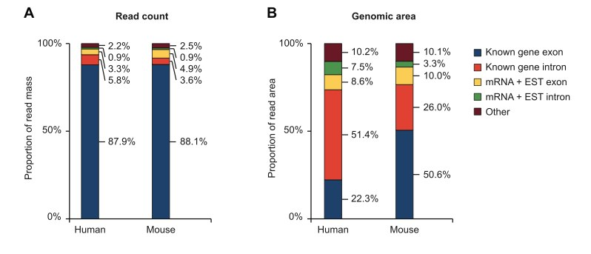

Slide 7
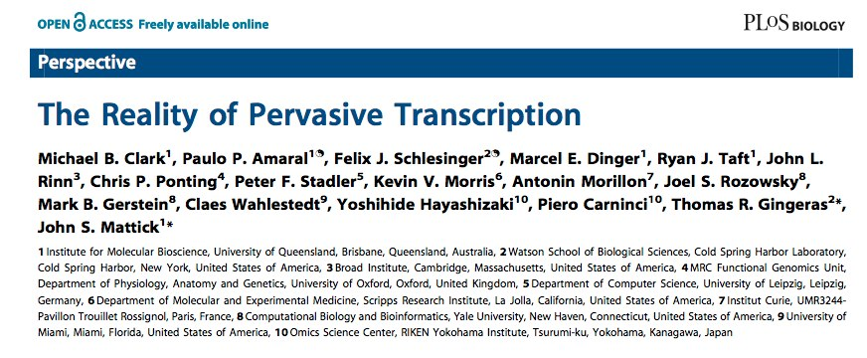

Slide 8
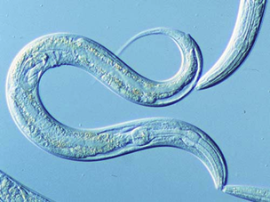
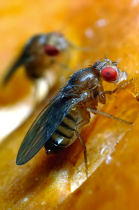
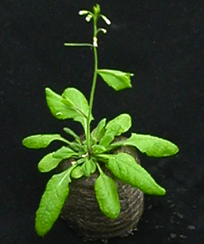
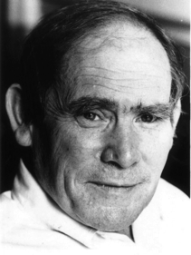
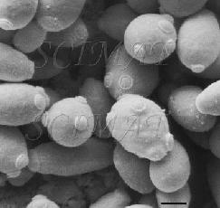
#protein-coding genes ≠cellular complexity
19,000
14,000
~20-25,000
6,000

Slide 9
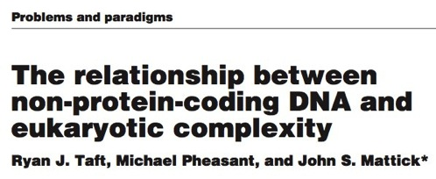
C-value paradox: historical observation that the amount of cellular DNA in different organism does not correlation with their relative biological complexity
  Example: amphibians & amoebae >> DNA per cell than mammals
G-value paradox: expectation that increased developmental complexity would be reflected in an increased number of protein-coding genes

Slide 10
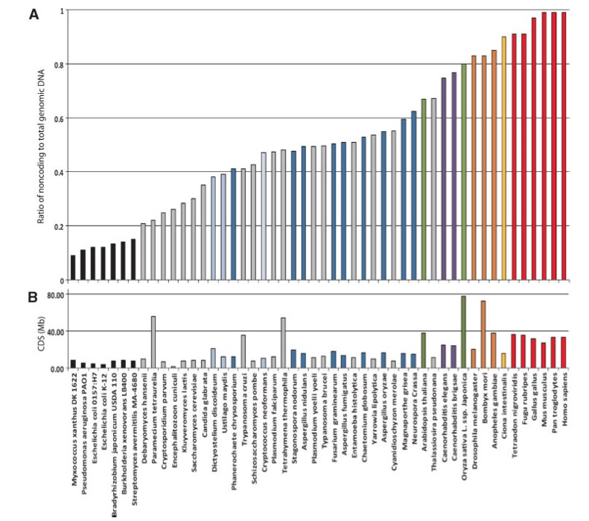
Ryan et.al, BioEssays 29:288–299 (2007 )

Slide 11
Long non-coding RNA
80% of the transcription in mammalian genomes is exclusively associated with long non-coding RNAs (lncRNAs)
>2 (some >100) kb in length, spliced and could contain polyA signals
No obvious ORF
Mouse transcriptome (~180,000)
  ~20,000 protein coding genes
  ~160,000 lncRNAs

Slide 12
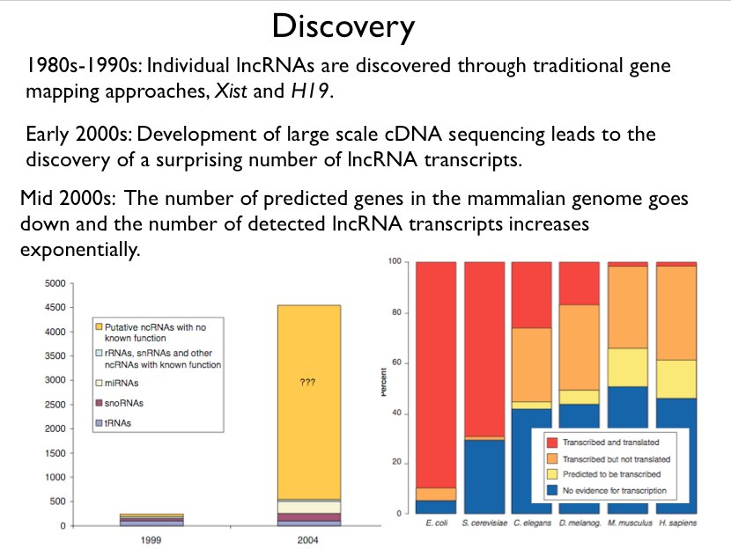

Slide 13
Regulated by various evolutionary scenarios
Inclusion of open reading frame disruptions in protein-coding genes
Chromosomal rearrangement of two untranscribed regions
Duplication of a noncoding gene by retrotransposition
Inclusion of neighboring repeats within a noncoding RNA
Insertion of a transposable element

Slide 14
Catagorization
"housekeeping" (tRNA rRNA, RNaseP) vs. Regulatory (H19, Xist)
"high abundance" (Xist, NEAT1) vs. "low abundance" (CCND1)
trans-acting vs cis-acting
loci of origin; sense, antisense, bidirectional, intergenic, totally intronic, partially intronic

Slide 15
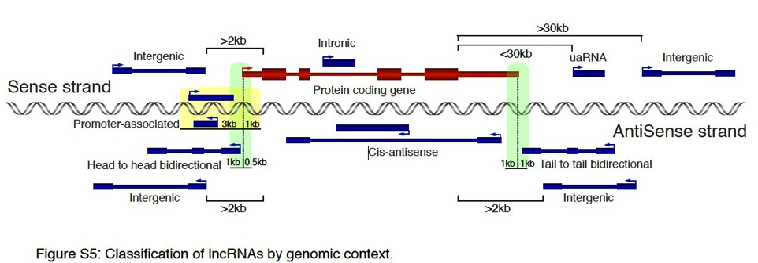
Clark MB. Genome-wide analysis of long noncoding RNA stability. Genome Res. 2012
Notes:
Figure shows different classifications of lncRNAs based on their genomic context. Classifications are based on
locations of lncRNAs compared to known coding genes. Hypothetical protein coding gene shown in red. LncR-
NAs in blue. Arrows show direction of transcription. Thick boxes represent coding exons, medium boxes are
noncoding exons, while thin boxes are introns. Green shaded area at 5’ of coding gene represents region in
which a lncRNA on the opposite strand can initiate and be classified as head to head bidirectional. Green
shaded area at 3’ of coding gene represents region in which a lncRNA can terminate and be classified as tail
to tail bidirectional. Yellow shaded area represents region in which a lncRNA can initiate and terminate and be
classified as promoter-associated. Note that aside from promoter-associated lncRNAs classifications were not
affected by the presence of absence of introns in the lncRNAs. Image not to scale.
Full definitions:
Intergenic transcripts were defined as ncRNAs not transcribed within 2kb upstream of a protein-coding region
on either strand or 30 kb downstream in sense direction or 2kb downstream in antisense direction.
3’UTR-associated transcripts (uaRNAs) were defined as as any ncRNA that initiates within 30 kb downstream
of a stop codon on the same strand (to allow for the potential of 3’UTRs that extend beyond their annotations
(Moucadel et al. 2007; Mercer et al. 2011)).
Head to head transcripts from bidirectional promoters were defined as transcripts that originate from the
antisense strand within 1 kb upstream or 0.5 kb downstream of the 5’ end of another RNA transcriptional start
site.
Tail to tail transcripts terminate on the antisense strand within 1000 nt downstream or 1000 nt overlapping the
termination site of another transcript.
Cis-antisense transcripts were defined as those lncRNAs where at least 90% of their exonic length overlapped
with a transcript on the opposite strand.
Exclusively intronic ncRNAs were defined as those that initiated and terminated within introns of protein-coding
genes in the sense orientation.
Inclusive intronic ncRNAs included any sense noncoding transcript where at least 75% of its exonic region
covers the introns of a protein-coding gene and allowed transcript initiation and/or termination within the coding
gene exons.
Promoter-associated transcripts were defined as single exon transcripts whose transcription was found within
3kb upstream and 1kb downstream of transcription start sites on either strand.
Note 1: Some lncRNA genomic categories are mutually exclusive but others are not.
Note 2: Some lncRNA genomic categories are defined by the distance from a protein coding gene (intergenic,
uaRNA, intronic) while others use the distance from any known transcript (bidirectional, cis-antisense,
promoter-associated)
Mercer TR, Wilhelm D, Dinger ME, Solda G, Korbie DJ, Glazov EA, Truong V, Schwenke M, Simons C, Matthaei KI et al.
2011. Expression of distinct RNAs from 3' untranslated regions. Nucleic Acids Res 39: 2393-2403.
Moucadel V, Lopez F, Ara T, Benech P, Gautheret D. 2007. Beyond the 3' end: experimental validation of extended
transcript isoforms. Nucleic Acids Res 35: 1947-1957.

Slide 16
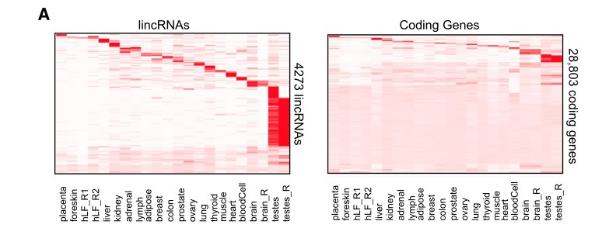
Cell and tissue specific expression
Cabili MN. Integrative annotation of human large intergenic noncoding RNAs reveals global properties and specific subclasses. Genes Dev. 2011 Sep 15;25(18):1915-27

Slide 17
Characterization: functional lncRNA
Paucity of Introns (nuclear localization)
Low GC content (low expression level)
Predicted ORFs have poor start codon and contexts (activation of nonsense-mediated decay pathway)
Significant similarity between lncRNA and 3’-UTR of mRNA (structural feature + sequence composition)
Niazi F. Computational analysis of functional long noncoding RNAs reveals lack of peptide-coding capacity and parallels with 3' UTRs. RNA. 2012 Apr;18(4):825-43.
Notes:
Paucity: Lack of, in small quantity

Slide 18
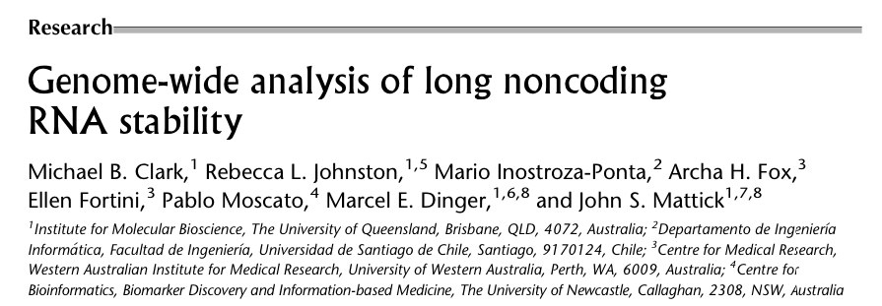
Custom microarray (Ncode, Life Technologies)
  7228 lncRNA
  27,281
Time Course Experiment
  0 hour, 30 min, 2,4,8,16,32

Slide 19
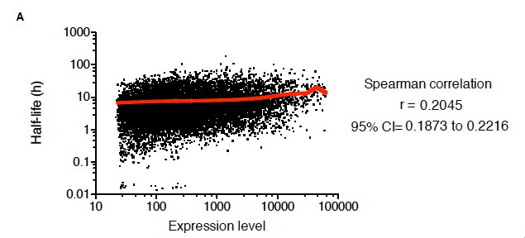
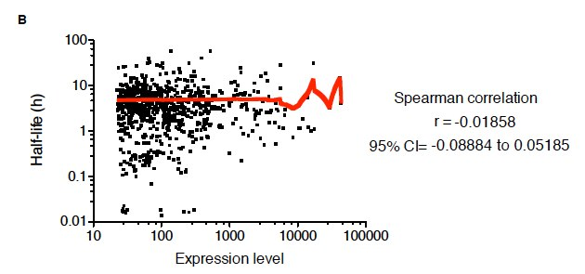
mRNA
lncRNA
Notes:
mRNA
Coarse Lowess curve is shown in red. A small positive correlation
between expression and half-life (Spearman correlation P <0.0001) is observed
lncRNA
There is no correlation
between expression and half-life (Spearman correlation P= 0.5945).

Slide 20
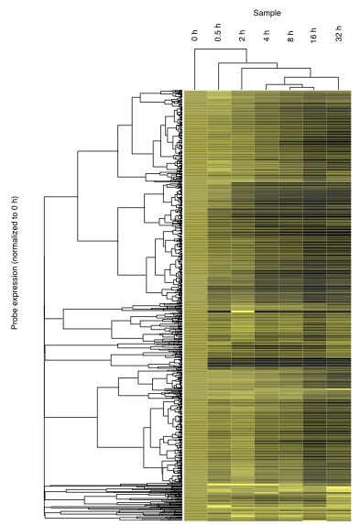
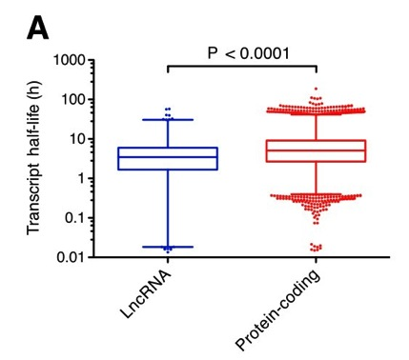
Notes:
The results shows that lncRNAs are not unstable as a class, although their half lives are on average shorter then protein coding RNAs.

Slide 21
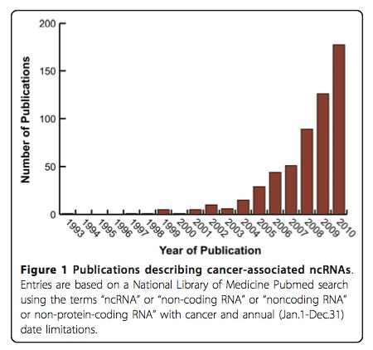
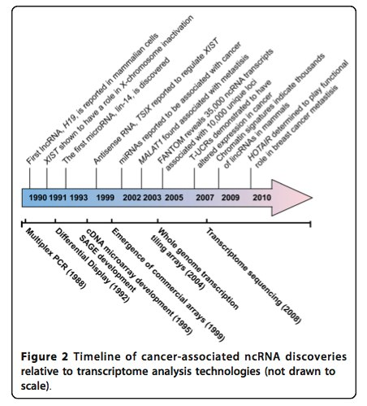
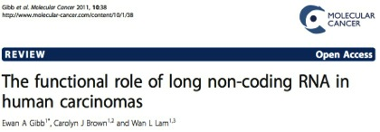
Getting traction

Slide 22
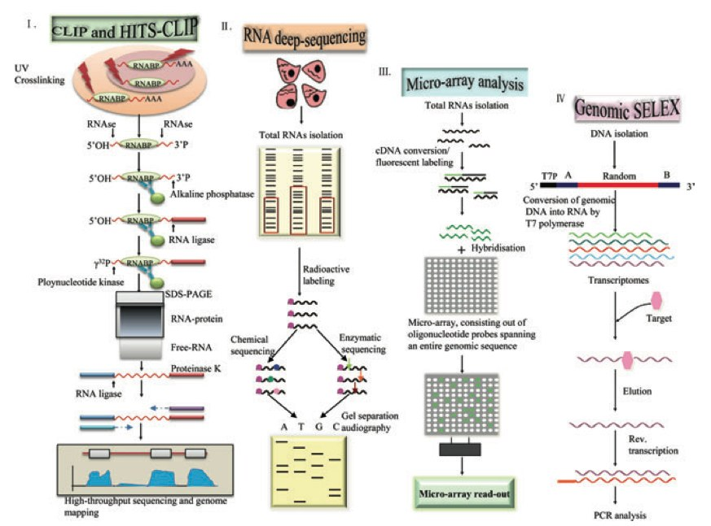
How to detect them?
Li X. Long Noncoding RNAs: Insights from Biological
Features and Functions to Diseases. Med Res Rev. 2012
Notes:
Figure 1. Experimental approaches to identify lncRNAs. A Identification of lncRNAs by high-throughput se- quencing of RNAs isolated by cross-linking immunoprecipitation (HITS-CLIP) methods. Schematic representa- tion of the HITS-CLIP protocol, RNA–protein complexes are covalently cross-linked in vivo using UV irradiation. The protein of interest is purified together with the bound RNA. To allow for sequence-specific priming of reverse transcription, an RNA adapter is ligated to the 3′ end of the RNA, whereas the 5′ end is radioactively labeled (γ32P).Cross-linkedprotein–RNAcomplexesarepurifiedfromfreeRNAusingSDS-PAGE.Afterpurification,pro- teinase K is used to remove the RNA-binding protein (RNABP), followed by linker ligation and RT-PCR to analyze the RNA sequences, using high-throughput sequencing methods. B Identification of lncRNAs by chemical or enzymatic sequencing of extracted abundant RNAs. C Identification of lncRNAs by microarray analysis. DNA oligonucleotides covering the sequence space of an entire genome are spotted onto glass slides, and hybridized to fluorescently labeled samples, derived from cellular RNA. D Identification of lncRNAs by genomic SELEX. By random priming, the genome sequence is converted into short PCR fragments containing a T7 promoter (T7p) at their 5′ region. Subsequently, conversion of genomic DNA into RNA by T7 RNA polymerase can then be assayed for function, such as binding to target proteins, by SELEX.

Slide 23
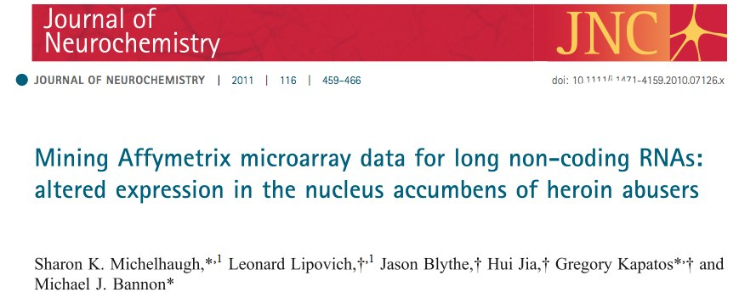

http://www.ebiomed.org/ncFANs/

Slide 24
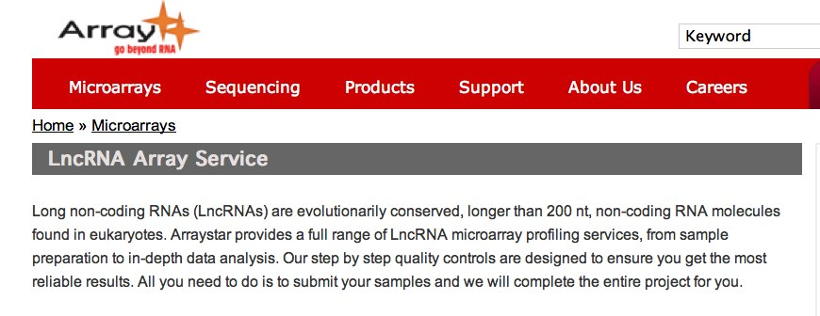
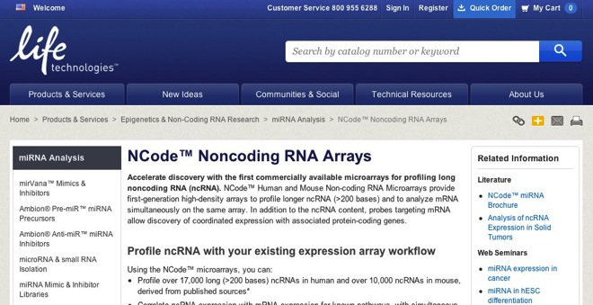

Slide 25
lncRNA Databases
Lncrna db (http://lncrnadb.com/)
FAMTOM3 (http://fantom.gsc.riken.jp/4/)
NONCODE v3.0
ncFANS

Slide 26
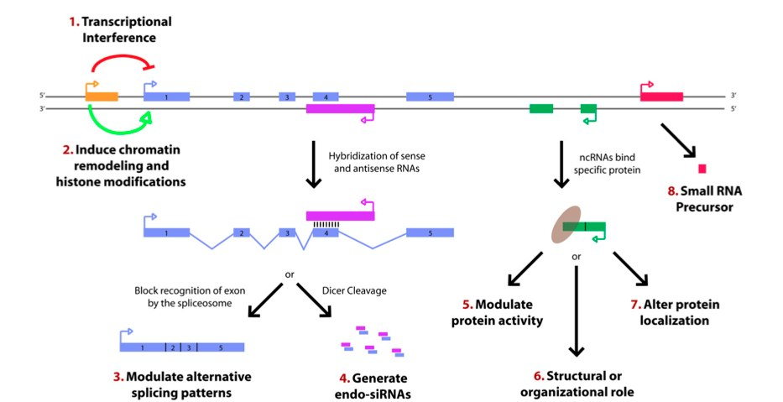
Potential functions of lncRNA
Wilusz JE, Sunwoo H, Spector DL. Long noncoding RNAs: functional surprises from the RNA world. Genes Dev. 2009 23(13):1494-504.
Notes:
Figure 1. Paradigms for how long ncRNAs function. Recent studies have identified a variety of regulatory paradigms for how long ncRNAs function, many of which are highlighted here. Transcription from an upstream noncoding promoter (orange) can negatively (1) or positively (2) affect expression of the downstream gene (blue) by inhibiting RNA polymerase II recruitment or inducing chromatin remodeling, respectively. (3) An antisense transcript (purple) is able to hybridize to the overlapping sense transcript (blue) and block recognition of the splice sites by the spliceosome, thus resulting in an alternatively spliced transcript. (4) Alternatively, hybridization of the sense and antisense transcripts can allow Dicer to generate endogenous siRNAs. By binding to specific protein partners, a noncoding transcript (green) can modulate the activity of the protein (5), serve as a structural component that allows a larger RNA–protein complex to form (6), or alter where the protein localizes in the cell (7). (8) Long ncRNAs (pink) can be processed to yield small RNAs, such as miRNAs, piRNAs, and other less well-characterized classes of small transcripts.

Slide 27
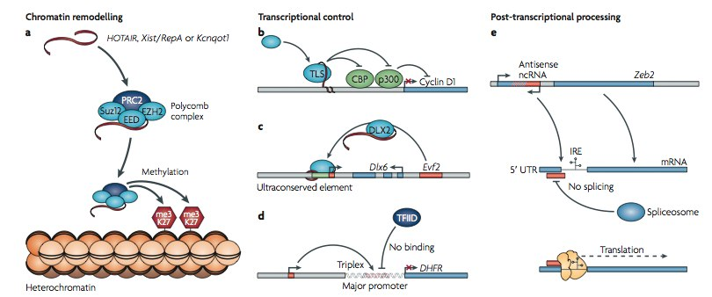
Known Examples
Mercer TR, Dinger ME, Mattick JS. Long non-coding RNAs: insights into functions. Nat Rev Genet. 2009 Mar;10(3):155-9
Notes:
Figure 2 | Functions of long non-coding RnAs (ncRnAs). Illustrative mechanisms by which long ncRNAs regulate local protein-coding gene expression at the level of chromatin remodelling, transcriptional control and post-transcriptional processing. a | ncRNAs can recruit chromatin modi- fying complexes to specific genomic loci to impart their catalytic activity. In this case, the ncRNAs HOTAIR21, Xist and RepA (the small internal non- coding transcript from the Xist locus)25, or Kcnqot1 (ReF. 24) recruit the Polycomb complex to the HoxD locus, the X chromosome, or the Kcnq1 domain, respectively, where they trimethylate lysine 27 residues (me3K27) of histone H3 to induce heterochromatin formation and repress gene expression. b | ncRNAs can regulate the transcriptional process through a range of mechanisms. ncRNAs tethered to the cyclin D1 gene recruit the
RNA binding protein TLs to modulate the histone aNcaetuyrletrRanevsfiewrass|eGaecnteivtitcys of CReB binding protein (CBP) and p300 to repress gene transcription29. c | An ultraconserved enhancer is transcribed as a long ncRNA, Evf2, which subsequently acts as a co-activator to the transcription factor DLX2, to regulate the Dlx6 gene transcription30. d | A ncRNA transcribed from the DHFR minor promoter in humans can form a triplex at the major promoter to occlude the binding of the general transcription factor TFIID, and thereby silence DHFR gene expression31. e | An antisense ncRNA can mask the 5′ splice site of the zinc finger homeobox mRNA Zeb2 from the spliceosome, resulting in intron retention. The translation machinery can then recognize and bind an internal ribosome entry site (IRe) in the retained intron, resulting in efficient Zeb2 translation and expression35.

Slide 28
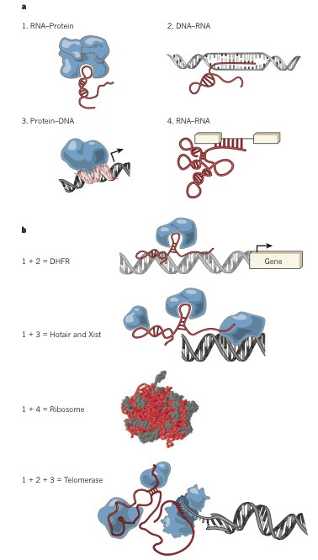
Modular principles of lncRNAs
Guttman M, Rinn JL. Modular regulatory principles of large non coding RNAs. Nature. 2012 482(7385):339-46
Notes:
Figure3|ModularprinciplesoflargencRNAgenes. a,Thefourprinciples of nucleic acid and protein interactions. (1) RNA–protein interactions, (2) DNA–RNA hybridization-based interactions, (3) DNA–protein interactions and (4) RNA–RNA hybridization based interactions. b, Each of these principles can be combined to build distinct complexes. For example, combining RNA– protein and RNA–DNA interactions can localize a protein complex to a specific DNA sequence in an RNA-dependent manner; as has been implicated for the DHFR99 promoter and localization of DNMT3b98. Combining RNA–protein and protein–DNA principles can also localize a diverse set of proteins, which have a molecular scaffold created by RNA, to a specific DNA sequence in a protein-dependent manner. The ribosome is a multifaceted combination
of RNA–protein interactions that facilitate correct RNA–RNA interactions for the ribozyme activity of the ribosome. The telomere replication activity of telomerase is an example of combining RNA–protein, RNA–DNA and protein–DNA interactions.

Slide 29
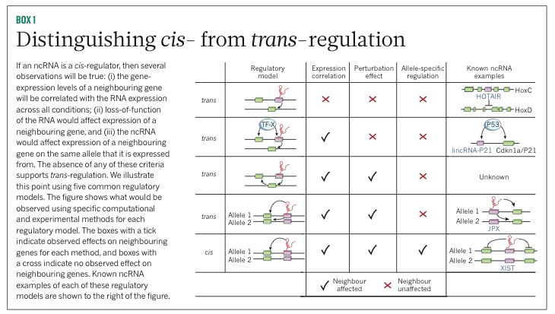
To cis or not to cis

Slide 30
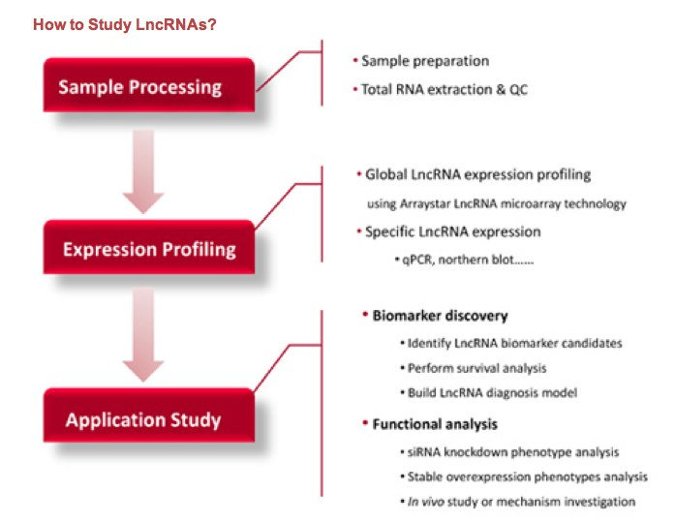
How to study them?

Slide 31
2 major approaches
Guilt-by-Association
RNAi knock down

Slide 32
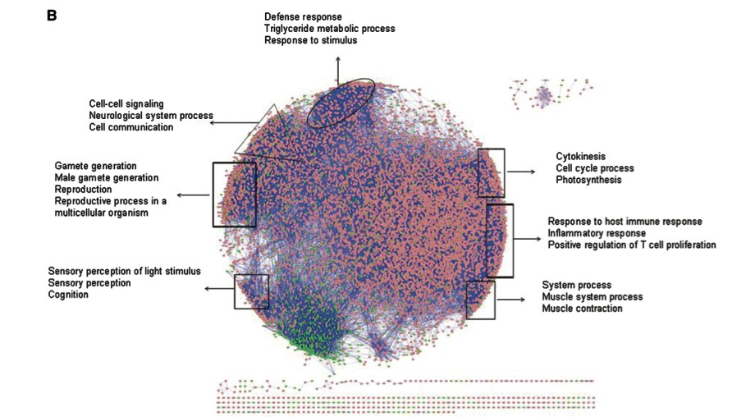
Co-expression network
Liao Q,. Large-scale prediction of long non-coding RNA functions in a coding-non-coding gene co-expression network. Nucleic Acids Res. 2011 May;39(9):3864-78

Slide 33
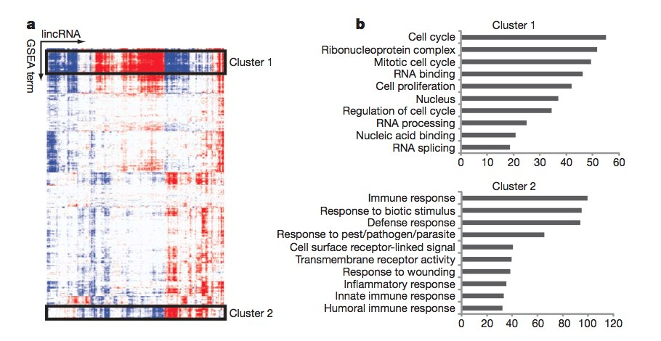
Correlation metrix
Guttman M. Chromatin signature reveals over a thousand highly conserved large non-coding RNAs in mammals. Nature. 2009 458(7235):223-7

Slide 34
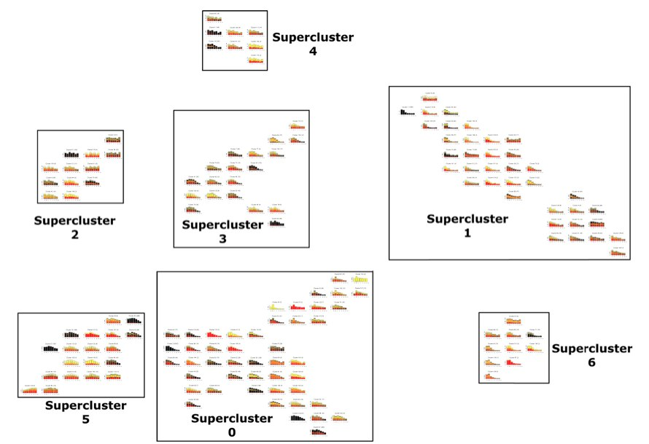
Clark MB. Genome-wide analysis of long noncoding RNA stability. Genome Res. 2012
Notes:
Figure 4.Distance-based clustering of transcript decay rates. Transcripts are automatically clustered; with those showing indistinguishable decay
profiles over the time course present in the same cluster, while transcripts with similar profiles are found in nearby clusters. The physical distance between
individual clusters and between super-clusters represents the degree of difference in the decay profile. Clusters of clusters or super-clusters are created by
applying the method used to form the clusters to the clusters themselves. Title gives the cluster number and the number of probes in the cluster. (X-axis)
Cumulative expression of all probes in the cluster. Decay profiles are stacked bar graphs with every stack representing a separate transcript; when there are
many transcripts in a cluster, the expression level of some transcripts cannot be individually visualized and are seen as areas of black (representing many
transcripts). An interactive version of this figure can be found at http://stability.matticklab.com/.

Slide 35
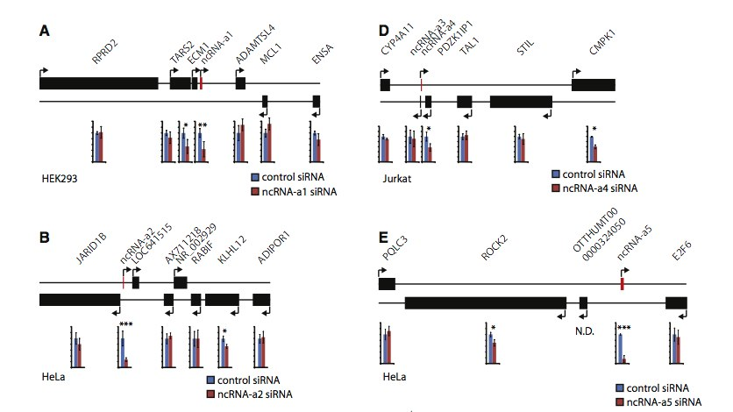
Knock down studies
Ørom UA. Long noncoding RNAs with enhancer-like function in human cells. Cell. 2010 143(1):46-58

Slide 36



Analysis Workflow of Long Non-coding and coding gene expression microarray in T cell differentiation
Tzu L Phang, Ping-Yao Zeng, and Edwin F. de Zoeten
Notes:
Slide 1:
First, I would like to apologize because I have changed my talk from the original title. Our NGS experiment hit a wall and was delayed.
Instead, I will talk about one of our older experiment where we measure lncRNA, together with mRNA, using microarray platforms
This is a collaboration between University of Colorado, and the Children’s Hospital of Philadelphia.
My name is Tzu Phang from University of Colorado.

Slide 37

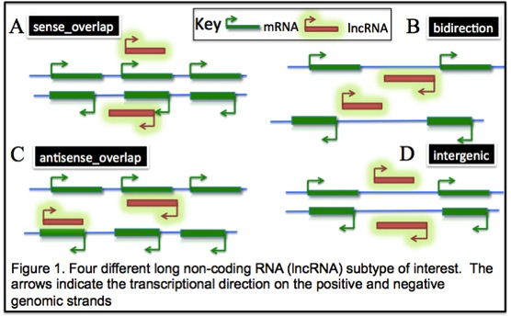
Protein coding genes ~23,000 (2%)
Long non-coding RNA
  > 200 nucleotides
  No obvious ORF > 100 AA
  Current estimation
    7000 – 23,000
  4 major types:
    Sense_overlap
    Antisense_overlap
    Bidirectional
    Intergenic
Potential Roles:
  Enhancer / inhibitor function to regulate surrounding gene expression
Notes:
Slide 2:
About 2% of human genome code for mRNA, which constitute about 23,000 genes, about the same for mouse. These mRNAs are then translated into protein, the biological machine for the cell.
Recent studies from Tiling and NGS experiments show that the genome is pervasively transcript, and some claimed that 90% of the genome is transcribed. One of the result is long non-coding RNA (lncRNA).
LncRNA is defined to have at least 200 nucleotide long and have no obvious ORF for at least 100 amino acids. The current estimate for lncRNA is around 7000 to 23,000. The microarray system we used for this experiment divides that lncRNA into 4 major types: sense_overlap, antisense_overlap, bidirectional and intergenic
LncRNAs same as mRNA with multiple exons
(Sense_overlap) lncRNA is located on the same strand on a protein coding gene. They were usually located in the UTRs and intron on the coding gene.
(Antisense_overlap) lncRNA is located on the opposite strand.
(Intergenic) lncRNA, as its name indicated is located in between protein coding gene
(bidirectional) lncRNA is a special class of lncRNA that similar to intergenic but almost always located near the upstream re, but on the opposite strand, of a protein coding gene
The role of lncRNAs are not well define, except for a few milestones such as HOTAIR, XIST and etc. However, many wet lab experiments show that they might exhibit enhancer or inhibitor function to regulate their surround genes expression.

Slide 38

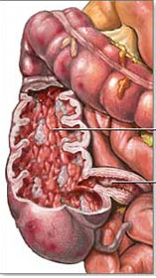
Inflammatory Bowel Disease (IBD)
  Crohn’s disease & Ulcerative colitis
  Autoimmune disease
    70 – 150 per 100,000 in USA
Mouse model demonstrate increased CD4⁺ T cell responses to antigen of the intestinal lumen
Study T cell lineages differentiation
  Develop novel therapeutics for IBD and for other autoimmune disease
Notes:
Slide 3:
Our journey started from the disease Inflammatory Bowel Disease (IBD) which includes both Crohn’s disease and Ulcerative colitis. IBD is an autoimmune disease and the incidence of IBD in the United States is 70-150 cases per 100,000 individuals and is on the rise
Our understanding of the immunologic mechanisms underlying IBD has advanced greatly in the past decade, mouse model of IBD demonstrate increased CD4+ T cell responses to antigens of the intestinal lumen
To under the system further, we have chosen to study the T cell lineages in mouse system. These cells, under the stimulation of specific cytokines differentiate into different T cell lineage. For example, the Naïve T cells can be differentiated into at least 3 different lineages under the right cytokine stimulation, and each lineages, such as Treg, Th17 will produce a whole host of cytokine to further the immune system.
Understanding the processes involved in this differentiation will provide targets to develop novel therapeutics for IBD as well as other autoimmune diseases.

Slide 39

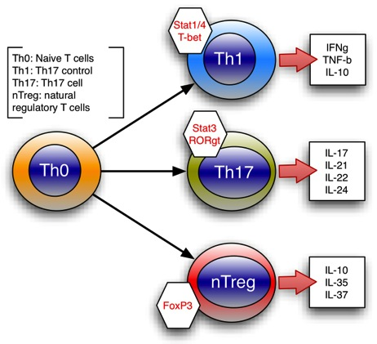



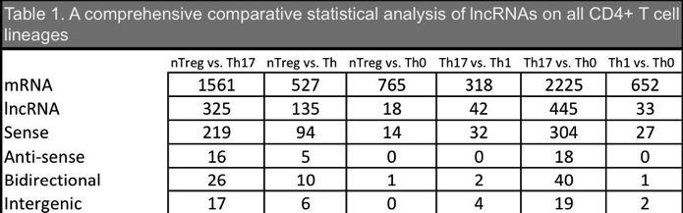





mRNA [15,457]
lncRNA [8,071]
  Sense [3,632]
  Antisense [1,204]
  Bidirectional [965]
  Intergenic [854]
Notes:
Slide 4:
We used a custom microarray from a company called “ArrayStar”. The platform measure > 15,000 mRNA and >8,000 lncRNA simultaneously. As shown here, the sense_overlap lncRNA dominated the lncRNA type, followed by antisense lncRNA. The two types of intergenic lncRNAs were quite comparable in amount. The company used many public databases to derived the lncRNA set, including RefSeq, UCSC genome, Ensembl, FANTOM3, RNAdb, ncRNA and a few other smaller organizations.
Our goal is to perform comparative studies on all 4 T cell lineages and identified significant mRNA, as well as lncRNAs.
Table 1 summarizes the comparison results.
KEY:
-- mRNA and lncRNA expressions are not proportional
---- nTreg vs. Th0: 765 mRNA vs. 18 lncRNA
---- Th1 vs. Th0: 652 mRNA vs. 33 lncRNA
-- A lot more Sense compare to antisense.

Slide 40

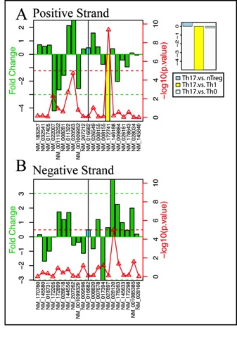
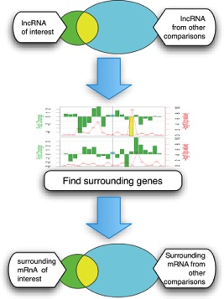

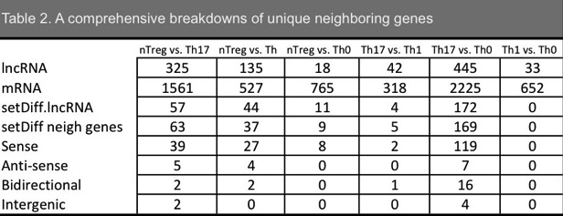
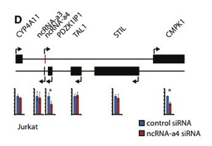
*
p < 0.00001
FC > 3
@
*
@
Orom UA. At el. Cell 143: 46-58. 2010
Notes:
Slide 5:
As mentioned, many studies shown that lncRNA could be regulating its surrounding genes, as shown in one of the landmark paper from the Orom's group, as shown in one of their figure:
-- D: the lncRNA (ncRNA-a) control the gene expression of CMPK1 4 genes away
The goal for the analysis is to pick up "unique" lncRNA in specific comparison that could be regulating "unique" mRNA expression.
Workflow
-- For a given comparison such as nTreg vs. Th17, we pick up significant lncRNA.
-- We compare this lncRNA list all other significant lncRNAs from other comparisons and pick up unique lncRNA
-- For a given unique significant lncRNA, we identify 10 upstream and downstream gene on both positive and negative strands in the genome
-- We identify significant "surrounding" mRNA by two statistical critirions: p < 0.0001 and Fold change > 3.
-- Again, we pick up the unique mRNA by comparing with mRNA selected from all other comparisons
-- Our final list of mRNAs are candidates gene that are to be validated by wet lab for lncRNA regulation.
The right figure illustrate how we define potential genes that might be regulated by perspective lncRNA.
-- The lncRNA in question is code name: uc009git, derived from UCSC_kg
-- The top panel is a representation of the positive strand of the genome
-- The bottom panel is the negative strand
-- The lncRNA is located on the negative strand and is a sense_overlap type located within the gene "Uba2" ubiquitin-like modifier activating enzyme 2
-- The significant surround genes must satisfy two criteria: [1] p < 0.0001 (marked by the red dotted line) and [2] at least 3 fold change (marked by the green dotted line)
-- In this case, the gene NM_172742 colored in yellow qualifies
(TH.vs.TS.27.CUST_5835_PI419771968.sense_overlap.-.pdf)
Table 2:
KEY:
-- Not many comparison share common lncRNA (Eg, nTreg vs. Th0: 11 of 18 are unique), indicating that lncRNA regulation could be specific to biological environment.
-- On average, one lncRNA regulate one potential mRNA gene.
--

Slide 41

Demonstrate a simple workflow to study potential role for lncRNA
LncRNA presents an opportunity to study the genome desert
LncRNA expression profile differ from mRNA indicate different regulation mechanism
Unique lncRNA under specific condition indicate their specific roles
Future direction – wet lab validation

Slide 42






People to know
John Mattick
Father of ncRNAs
Jeannie Lee
John Rinn
Tom Cech
Howard Chang
Ulf Andersson Orom

